Slide 1
For Loop
by Rachael Sera
for Junior Knights

Slide 2
Loops
Loops allow us to repeat code

Slide 3
While Review
They have a Boolean condition
If the condition is true, do what’s inside the loop, and then check the condition again
If the condition is false, skip the code inside the loop and move on to the code that follows
We had to do 2 important steps:
Create a variable outside the loop (e.g. “counter” or “i”)
Increment that variable inside the loop (otherwise the condition would either be always true or always false)

Slide 4
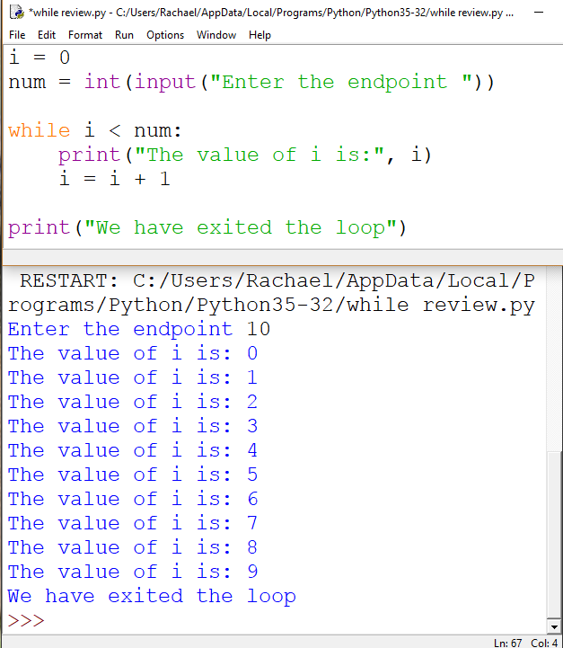
While Loop
Notice how the value of i changes in each iteration of the loop
We assign 0 to be the first value in i, and we increment is by 1 on each iteration
We execute the loop “while” i is less than num

Slide 5
For Loop
For loops do those 2 important steps for us
By default:
initialize the variable to 0
increment the variable by 1 with every iteration of the loop

Slide 6
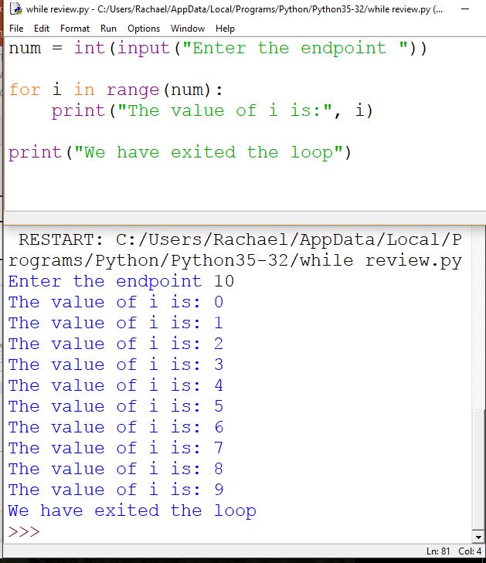
For Example 1
This code achieves the same output as the while loop code did
We can use any variable name we want, but I’m using i here again to be the iterating variable.
It’s automatically initialized to 0 and incremented by 1 with every iteration of the loop.
The range goes up to but not including the number inside
i.e. it is equivalent to < and not <=

Slide 7
For Example 1
Let’s break down that the loop is doing.
First, i is initialized to 0 (i = 0).
Then we check if i < num. If it’s true, we go in the loop.
Then we increment i (i = i + 1).
Then we go back to step 1 and repeat until i < num is false, at which point we skip over the code in the loop and execute whatever comes next (in this example, printing that we’ve exited the loop)

Slide 8
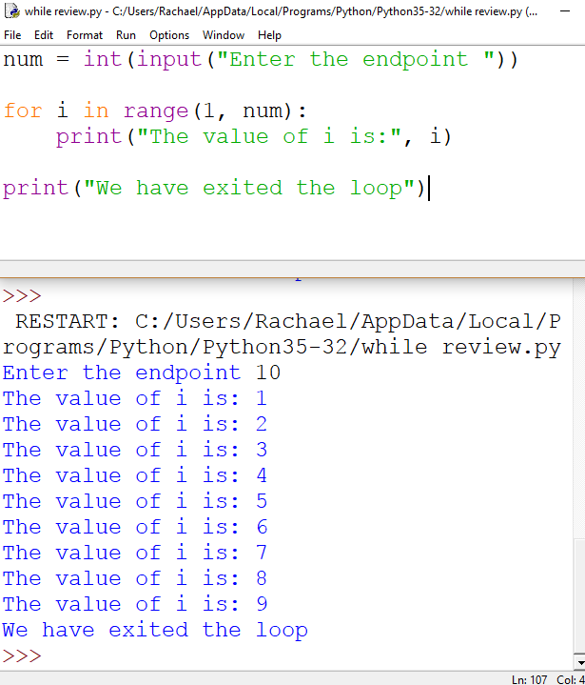
For Example 2
We can specify a different starting value of i by adding the desired starting value in as an additional argument to range()
So if we use range(1, num) then i will start at 1 instead of 0
Again, the range goes up to but not including the number inside

Slide 9
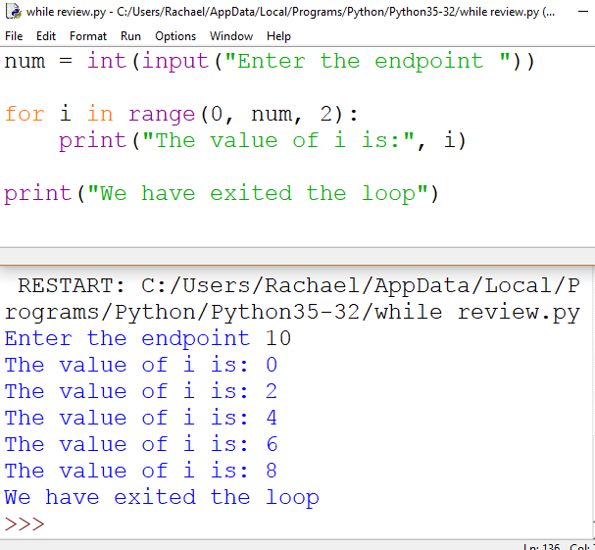
For Example 3
We can also specify a different incrementation for i every time instead of i=i+1
So if we use range(0, num, 2) then i will increment by 2 every time instead of 1 (i=i+2)
Note that if we want to change that incrementation value, we must also include the starting value (even if we want it to start at the usual default value of 0). Otherwise, it would think num is the starting value and 2 is the endpoint.

Slide 10
Example Sum of even numbers
Write a program to ask the user for a number. Sum all of the even numbers up to that number.

Slide 11
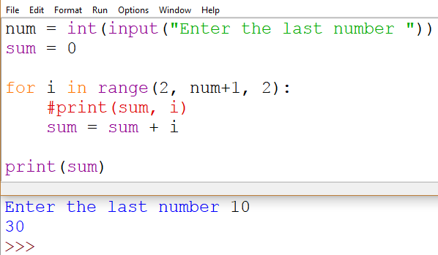
For loop Example Sum even numbers
We’ll need an accumulator like we do for other sum problems, initialized to 0
Let’s choose the starting and incrementation values for i
We can print sum and i to check ourselves and make sure the variables store the values they should
We can make the loop include num if we make our condition check num+1

Slide 12
Loop Control Elements
Break
Stops looping. “Breaks” out of the loop.
Continue
Does not execute the rest of the code after it appears in the loop, but does go back up and check the condition again, and “continues” the loop if the condition is true

Slide 13
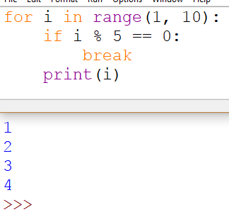
Break With condition
If we print i in every iteration of the loop, we’d print 0-9
We add the if statement so that every time i is divisible by 5, we continue. This occurs for the first time when i = 5.
Break means we stop right where we’re at in the loop and exit. So no more numbers once we reach 5 are printed.
Notes:
Do break example without mod first. No condition to start.

Slide 14
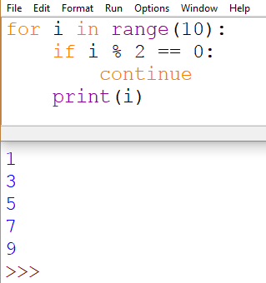
Continue
If we print i in every iteration of the loop, we’d print 0-9
We add the if statement so that every time i is an even number, we continue. That means we stop right where we’re at in the loop and we go back to check the condition for the next iteration.
Notes:
Do continue example without mod first

Slide 15
Example: Check if a Number is Prime Using Flag and break/continue
Write a program that has the user enter a number. Check if the number is prime, and print out whether it is or not.

Slide 16
